Slide 1
A Project Seminar on Loan Approval Estimation Deploying Deep Learning and Blockchain Technologies
Team Details
Sai Vishwanth(20EG105101)
Jaya Sravani(20EG105119)
Manikanta(20EG105156)
Chandana(20EG105160)
Project Supervisor
Dr. G Bala Krishna
Assistant Professor

Slide 2
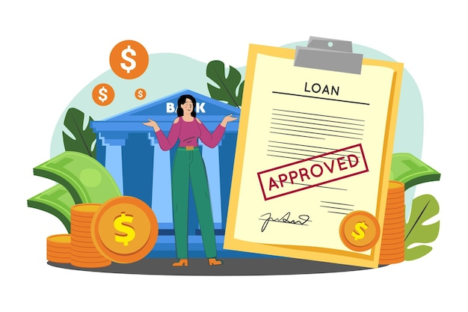
Introduction
In the contemporary banking sector, there is a pressing demand for rapid advancements as technology strives to meet the industry's evolving needs.
With a surge in loan applications, there is a critical emphasis on swift, accurate, and reliable loan approval models that effectively assess risks.
It must also ensure that the data is secure and transparent processes with tamper-proof for integrity.

Slide 3










Concept Tree
Can the customer pay back?
Is it profitable to bank?
Approval
Customer needs loan
Bank

Slide 4
Literature
Journal name /Publisher | Strategies | Advantages | Disadvantages
Springer - 2023 | Assessment of Credit Risk using an Adaptive Binarized Spiking Marine Predators’ Neural Network | Using deep learning techniques which performs with high accuracy | Enhancing the model with blockchain technology ensures data security, while integrating a user-friendly interface enhances accessibility and usability
International Journal of Engineering and Management Research -2023 | Random Forest, Naive Bayes, Decision Tree, and KNN. | Random forest gives highest value of accuracy(83%) | The absence of a user-friendly interface is a significant drawback for this model.

Slide 5
Literature(cont..)
Journal name /Publisher | Strategies | Advantages | Disadvantages
INTERNATIONAL JOURNAL OF INNOVATIVE RESEARCH IN TECHNOLOGY -2022 | Decision Tree | User-friendly application. | The accuracy can still be improved using deep learning techniques. Current application is 81% accuracy
International Research Journal of Modernization in Engineering Technology and Science -2023 | Logistic regression, Random forest, SVM, K Neighbors , Decision tree | Easy to implement | The absence of a user-friendly interface is a significant drawback for this model.

Slide 6
Problem Statement
The current banking industry faces significant challenges when it comes to the loan approval process. Due to long wait times, security risks, and reliance on old systems, which slow down the loan process.
Current methods, though developed, aren't fully connected from start to finish. This calls for a thorough approach to create a smooth and strong solution.
To address these limitations, we propose a solution that combines Deep Learning and Blockchain to enhance loan approval security and provide faster processing times.

Slide 7
Problem Illustration
OBJECTIVES:
Develop a model for loan approval prediction.
Implement a data storage system to enhance transparency and guarantee the tamper-proof integrity of the data.
Create a user-friendly interface for seamless interaction and accessibility.

Slide 8
Proposed Method
Deep learning model:
Data collection: Kaggle dataset
Preprocessing :
- Imputation: replace the null values with a mean of the column.
- Handling outlines: IQR method
- Transfer categorical to ordinal data
- Convert required columns to integer datatype
- Normalization of data
Split into train and test dataset
Utilize the sequential neural network architecture with 4 hidden layers for with activation function of ReLU with neurons 128, 256,256, and 256 respectively, linear activation for output.
Train the model on train data sets uprising historical known data including approved and denied cases.
Finetune the hyperparameters through rigorous experimentation which gives an improved accuracy.

Slide 9
Flow of Deep learning model
Handling Outliners
Transfer categorical to ordinal data
Converting required columns to integer datatype
Data Collection
Imputation
Pre-processing
Normalization of data
Deep learning model
Sequential neural network with ReLU activation
Convert into pickle file
Train the model
Split train and test data
Correlation matrix

Slide 10
Procedure for connecting the DL model and blockchain
Application:
The converted pickle file is deployed in Flask web framework
The Frontend is connected to the Flask and predicted output is reflected on frontend
Construct and deploy a smart contract for data storage
Using the ether.js library we can connect to the blockchain environment
When a user clicks on “save data” it connects to MetaMask and requests to implement a smart contract function
Once the request is approved the information is successfully stored on the blockchain
Currently the application is runned on the Seploia test network.

Slide 11

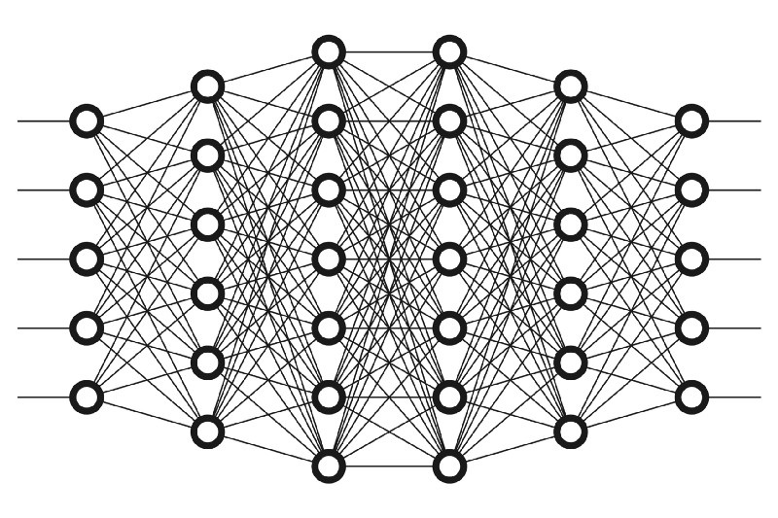










Architecture
Frontend
Backend
Deep Learning Model
Input
Predict
Converted into
Prediction
model.pkl
User
Save Data
Data Stored

Slide 12

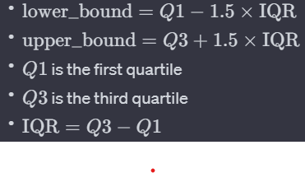
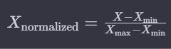
Parameter
Formulas used:
Mean:
i​
Inter Quartile Range:
Normalisation:

Slide 13
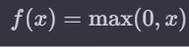



Parameter
Formulas used:
ReLU:
i​
Sigmoid:
Linear:
Mean Absolute Error:

Slide 14
Experiment Environment
Deep Learning Model:
Dataset : Kaggle dataset (credit_risk_dataset)
Libraries: NumPy, Pandas, MatplotLib, ScikitLearn, TensorFlow, pickle
Application:
Text Editors/IDEs: Visual Studio Code, RemixIDE
Package Managers: npm (Node Package Manager), pip (Python Package Installer)
Web Extensions: MetaMask
Frontend Libraries and Frameworks: React.js, Ethers.js
Backend Frameworks: Flask
Development Language: JavaScript, Python, Solidity
Testnet: Sepolia Testnet

Slide 15
Project status
S.No | Functionality | Status (Completed /in-progress/Not started)
1. | Creating a basic Deep Learning model to predict loan approval | Completed
2. | Integrate the Deep Learning model with the Front-end application | Completed
3. | Construct and deploy a smart contract for data storage | Completed
4. | Connect the application with the Blockchain environment and the smart contraction using ether.js and MetaMask | Completed
5. | Finetuning parameters and experimenting to improve accuracy of the model | In-progress

Slide 16
References
[1].1Vadipina Amarnadh • 2Nageswara Rao Moparthi Prediction and Assessment of Credit Risk using an Adaptive Binarized Spiking Marine Predators’ Neural Network in Financial Sector
[2]. Viswanatha V, Ramachandra A.C, Vishwas K N and Adithya G. “Prediction of Loan Approval in Banks using Machine Learning Approach”. International Journal of Engineering and Management Research e-ISSN: 2250-0758 | p-ISSN: 2394-6962
[3]. Anurima Majumdar, Romik Banerjee, Rounak Ghosh, Sagar Ghosh, Rudradip Bhattacharjee5, Sayak Saha6, Subhrajit Pallob7, Antara Ghosal8, Palasri Dhar9, Nabaneeta Banerjee1. “Loan Prediction by using Machine Learning”. INTERNATIONAL JOURNAL OF INNOVATIVE RESEARCH IN TECHNOLOGY June 2022 | IJIRT | Volume 9 Issue 1 | ISSN: 2349-6002
[4]. Mamatha, Madhura, Mahalakshmi Mukri. “PREDICTING LOAN APPROVAL USING MACHINE LEARNING”. International Research Journal of Modernization in Engineering Technology and Science ( Peer-Reviewed, Open Access, Fully Refereed International Journal ) Volume:05/Issue:05/May-2023

Slide 17
Thank you

Slide 18
Project seminar–I Evaluation
S.No | Rubrics | Marks
1 | Concept Introduction | 4
2 | Literature and Parameter | 5
3 | Problem and Problem Illustration | 8
4 | Proposed Method and Illustration | 8
Total |  | 25

